Slide 1
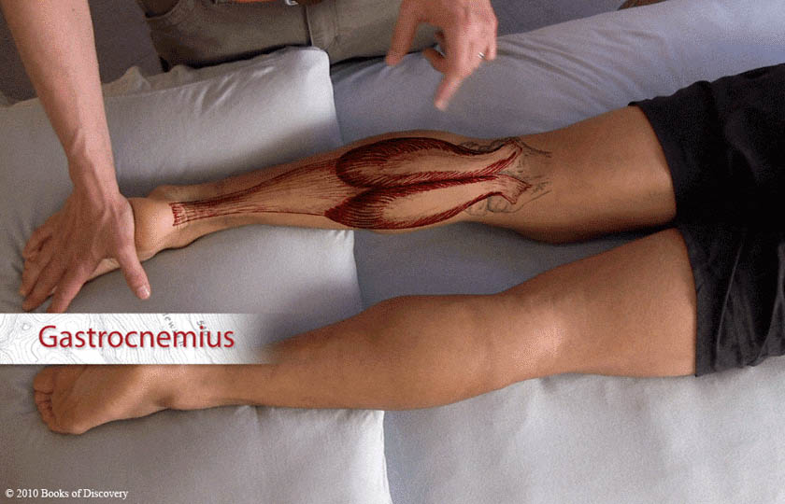
Gastrocnemius – prone

Slide 2
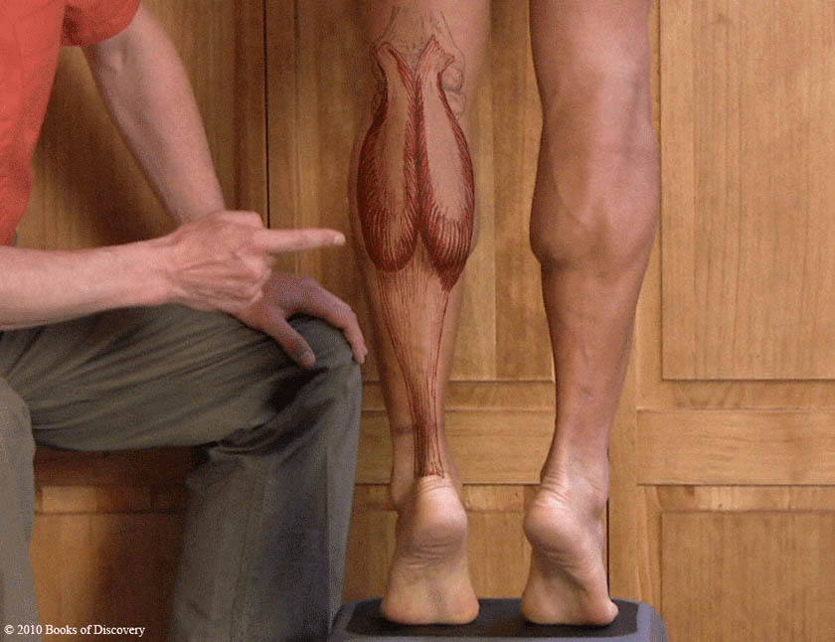
Gastrocnemius – standing

Slide 3
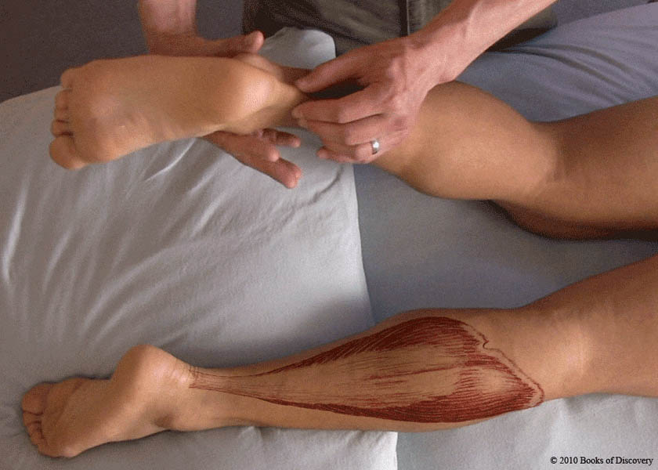
Soleus – prone

Slide 4
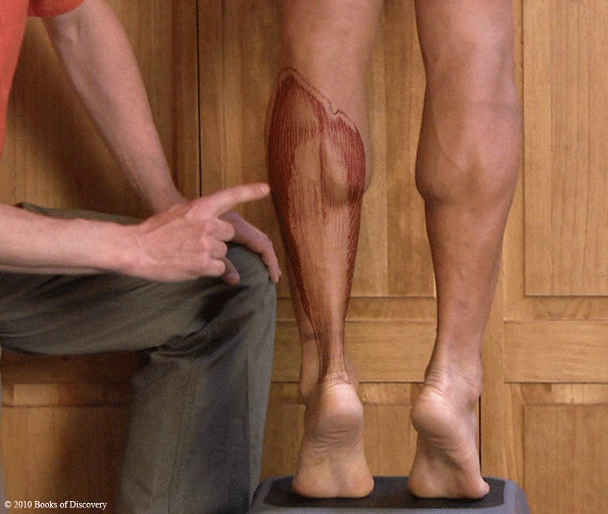
Soleus – standing

Slide 5
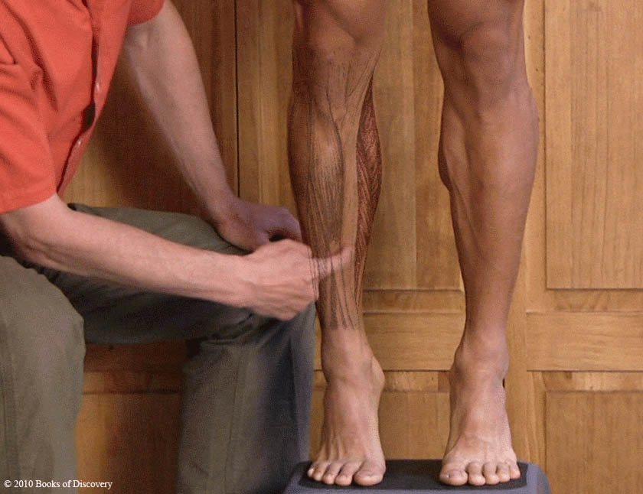
Soleus – standing, anterior view

Slide 6
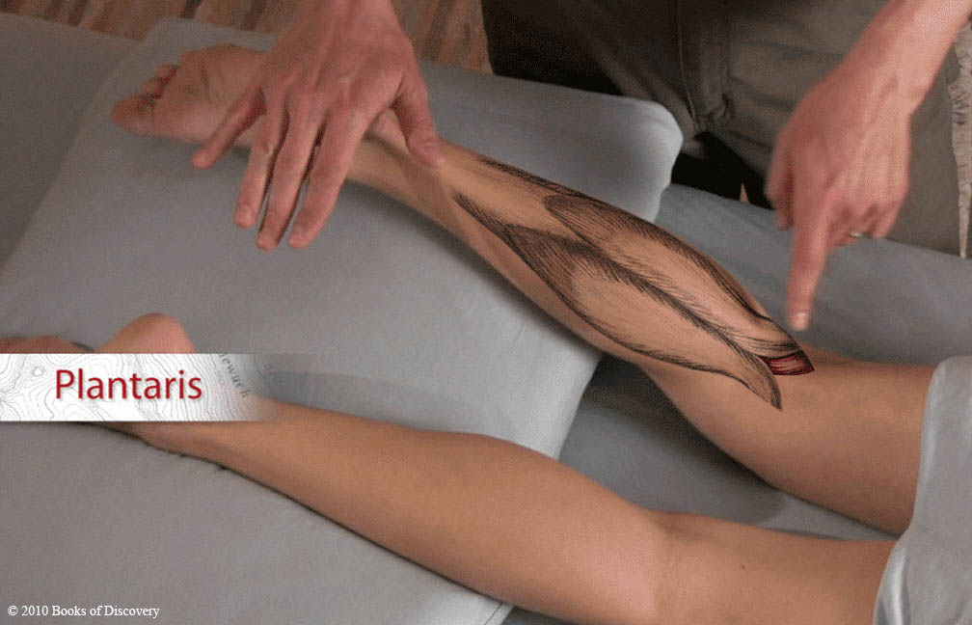
Plantaris 1

Slide 7
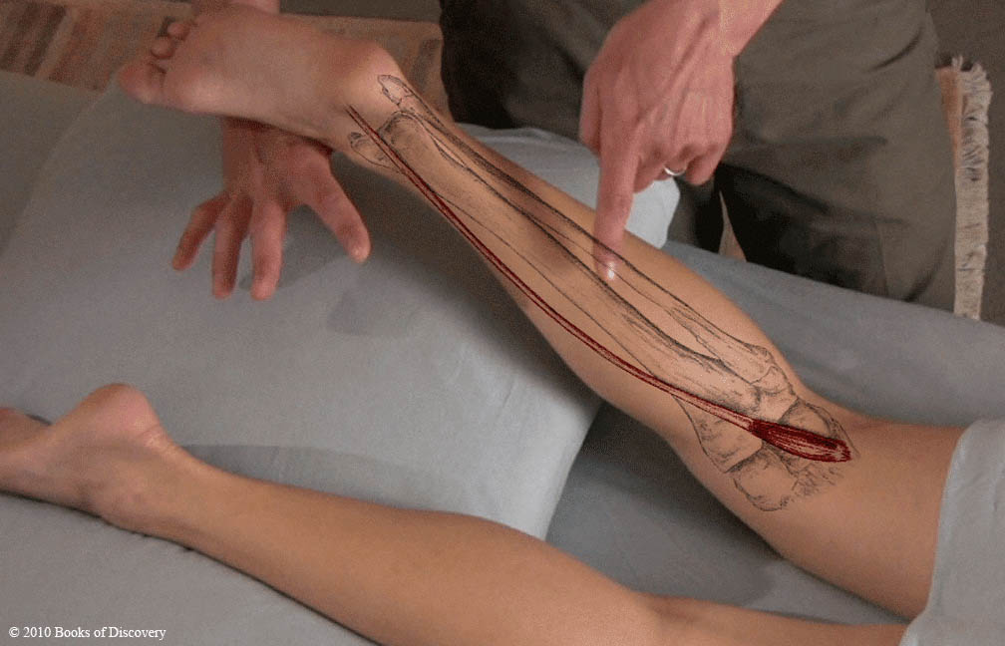
Plantaris 2

Slide 8
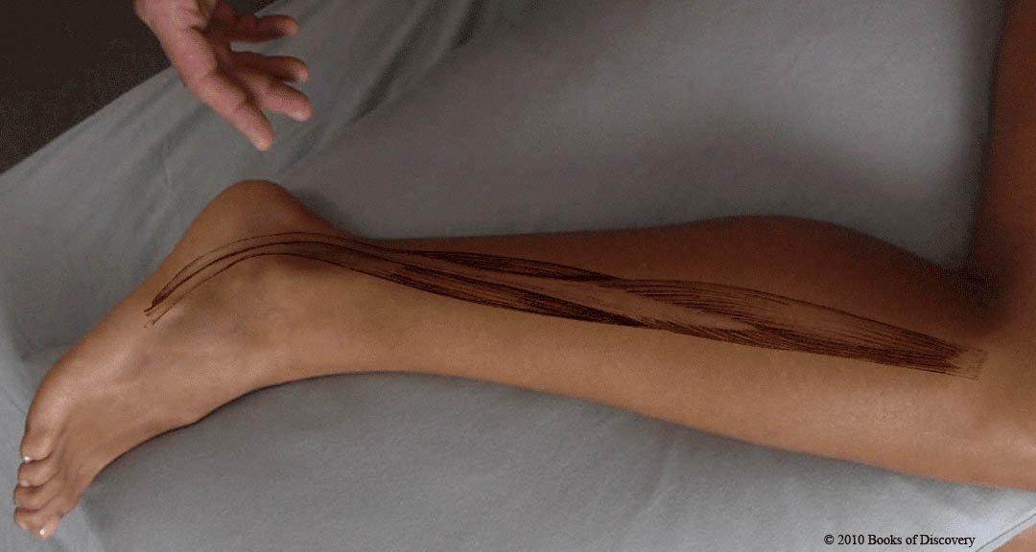
Peroneals

Slide 9
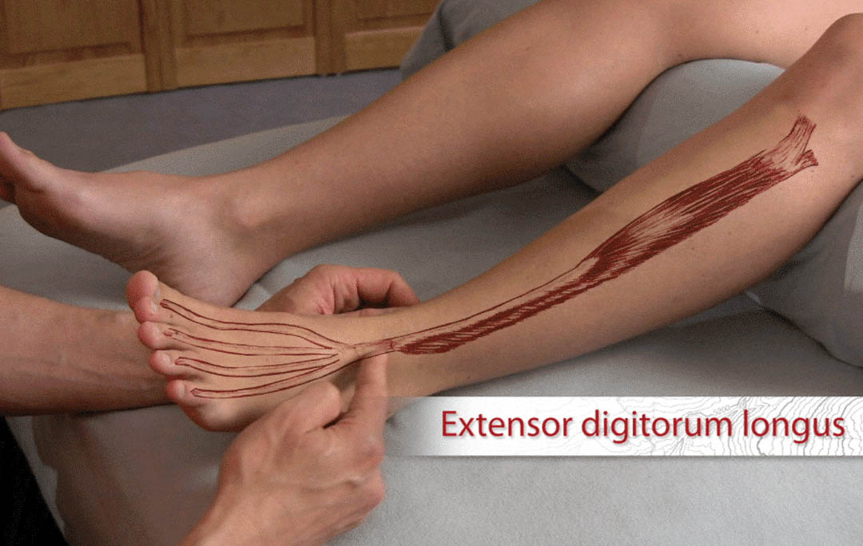
Extensor digitorum longus

Slide 10
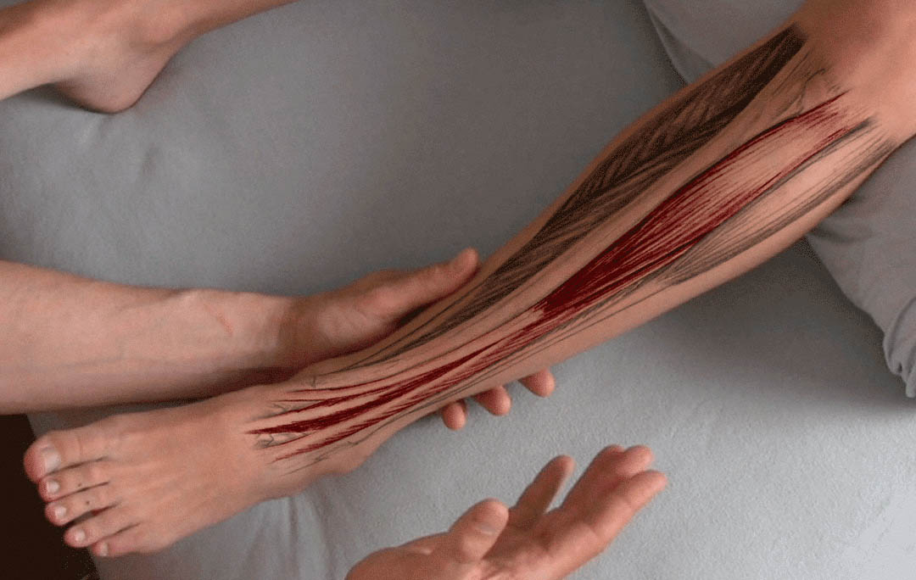
Extensors together

Slide 11
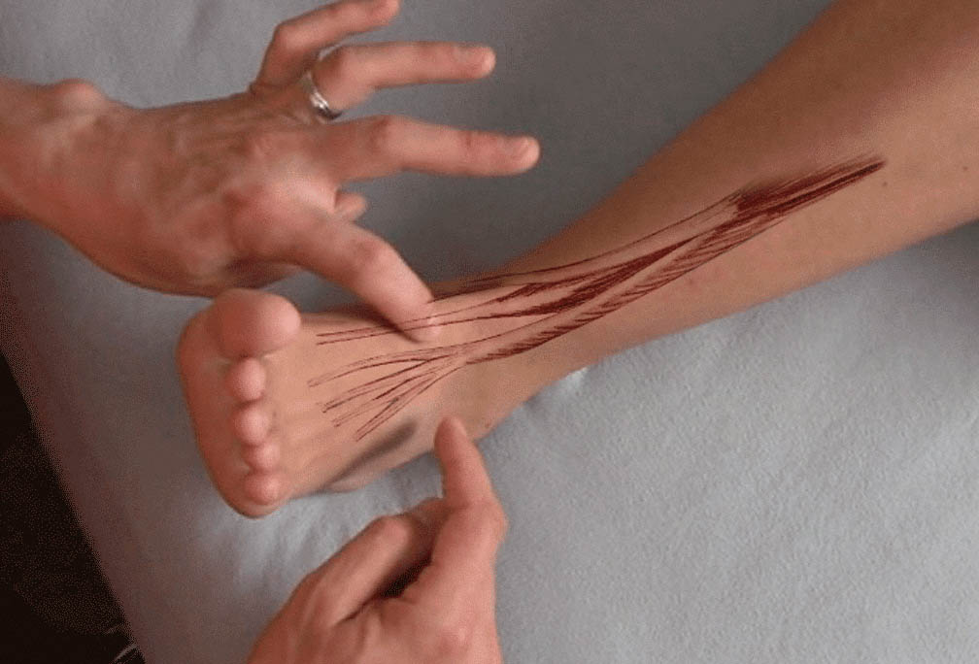
Extensor tendons together

Slide 12
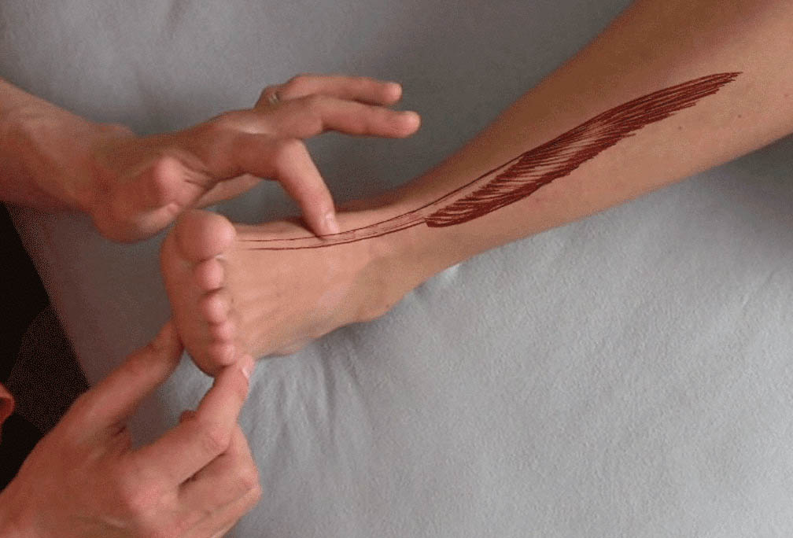
Extensor hallucis longus

Slide 13
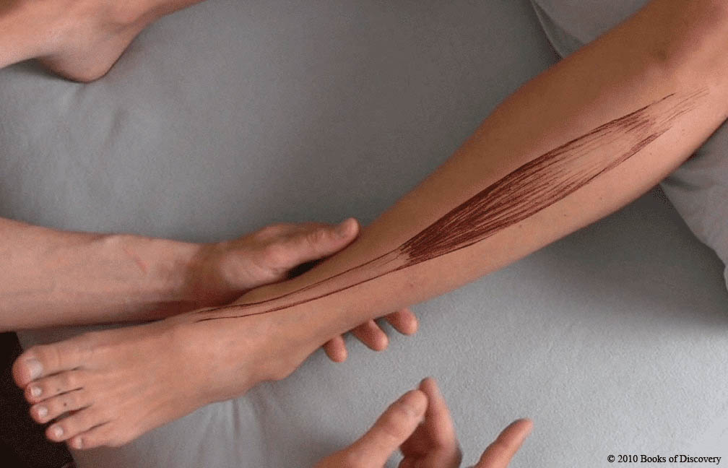
Tibialis anterior

Slide 14
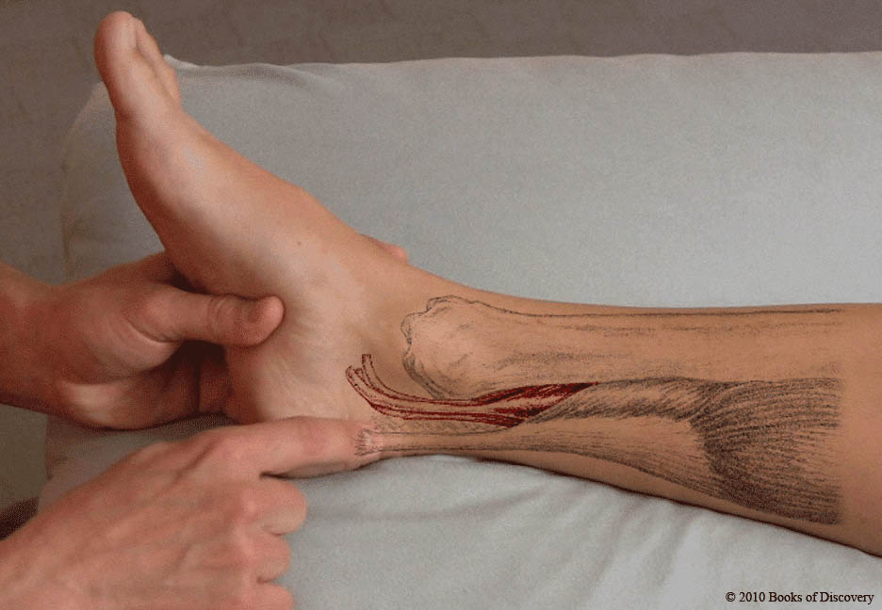
Flexors of the ankle and toes

Slide 15
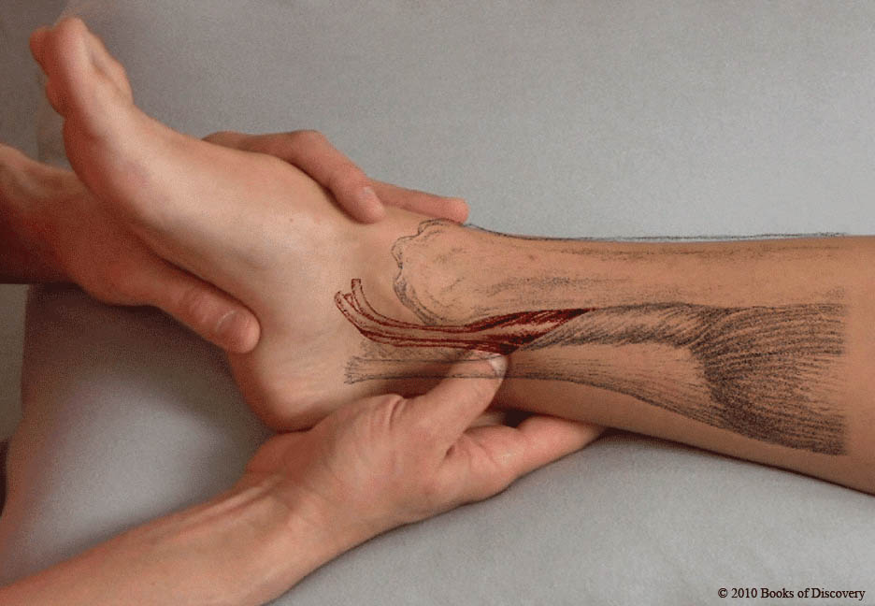
Flexors - palpate

Slide 16
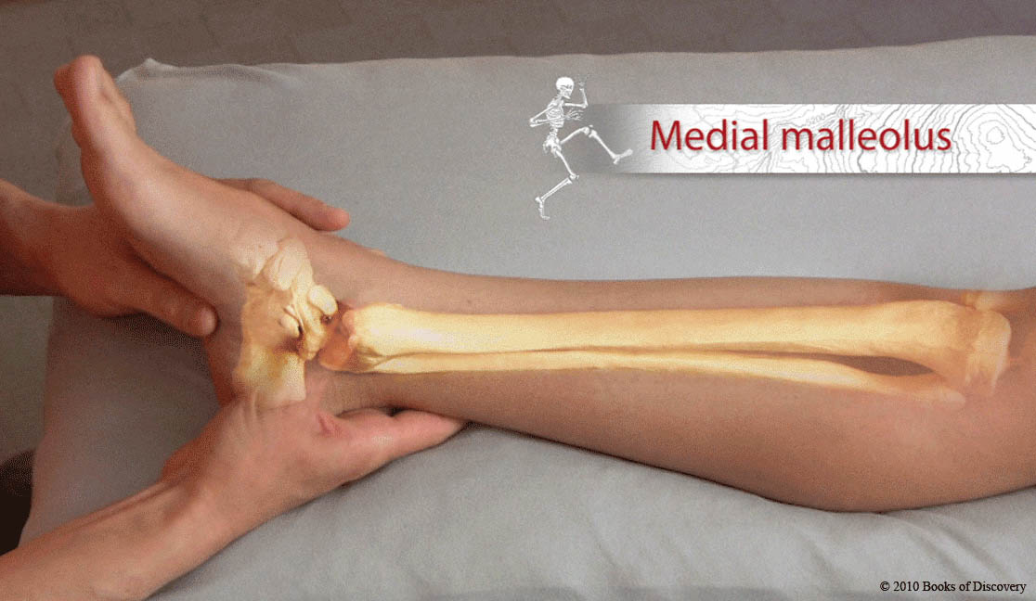
Medial malleolus

Slide 17
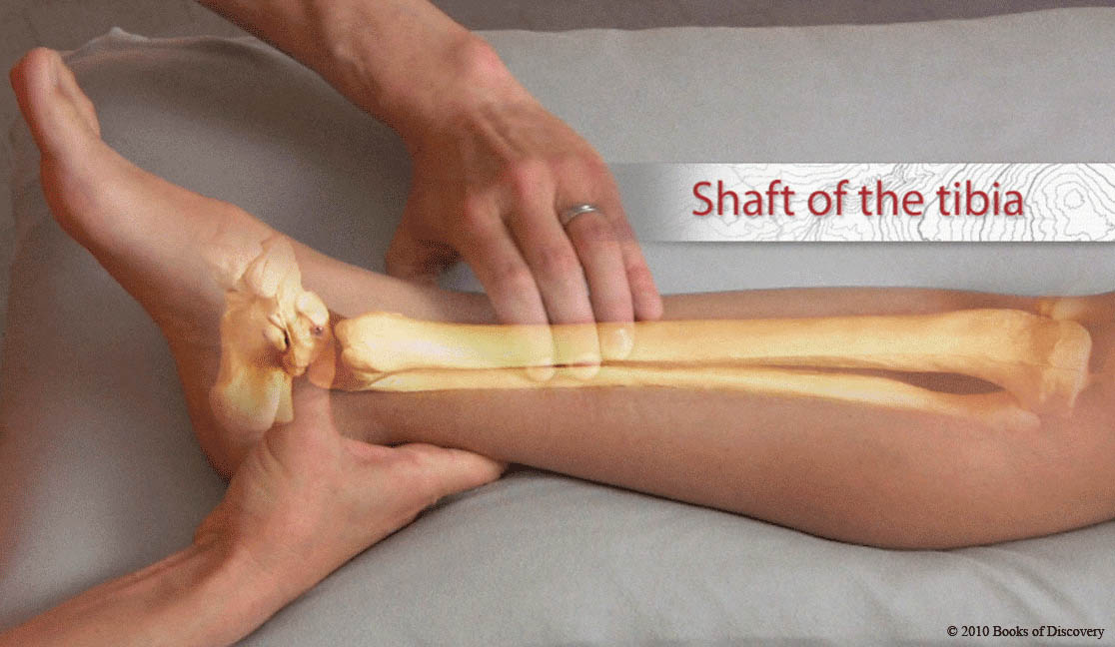
Shaft of tibia

Slide 18
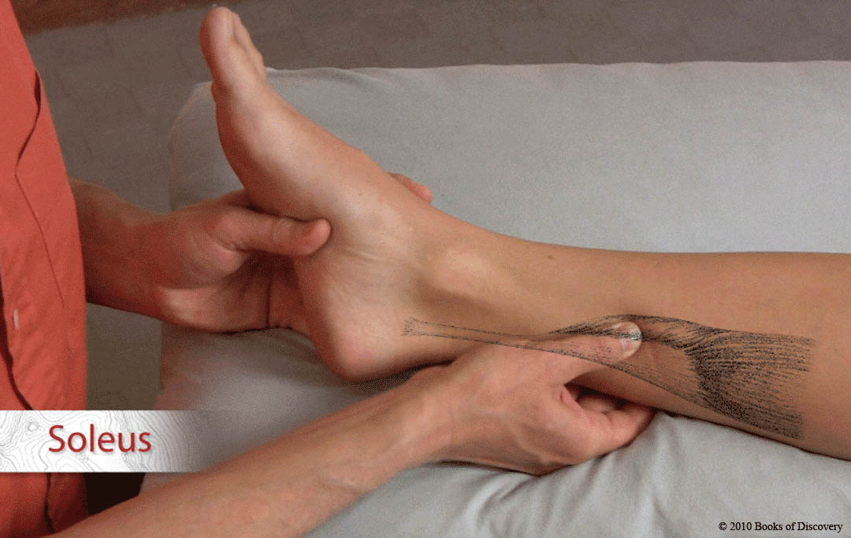
Soleus

Slide 19
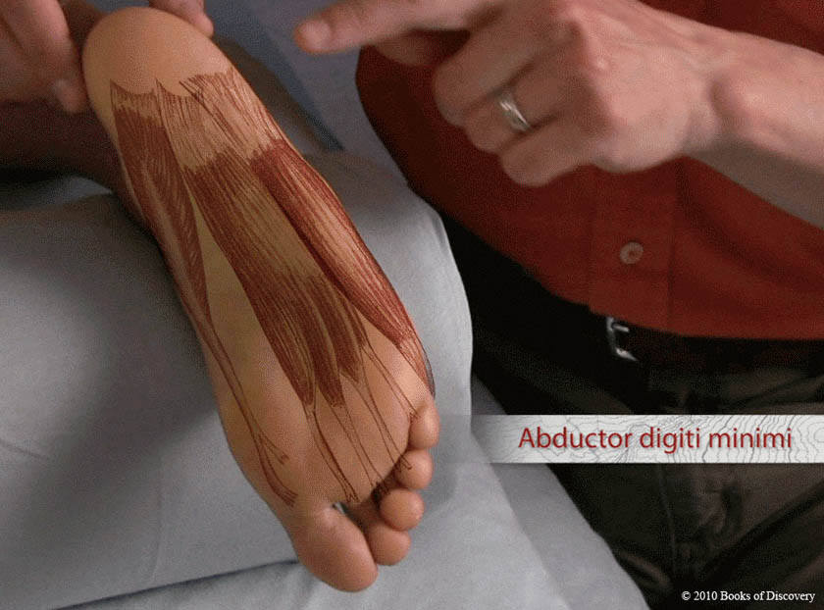
Abductor digiti minimi

Slide 20
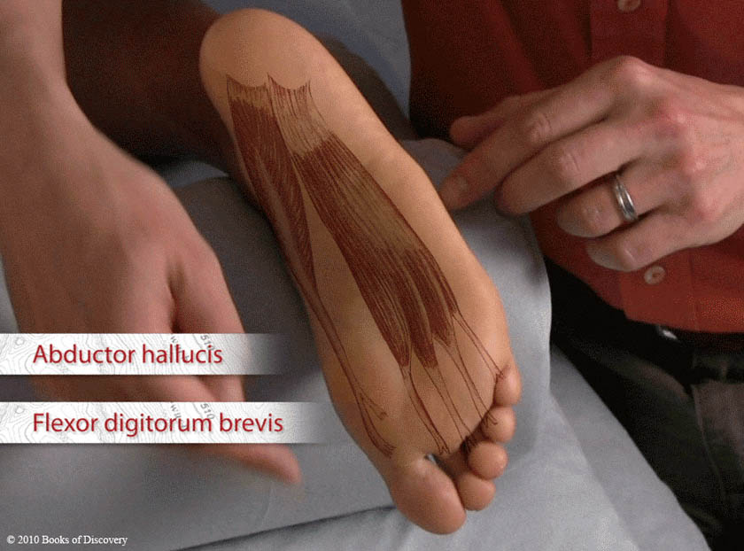
Abductor hallucis &
Flexor digitorum brevis

Slide 21
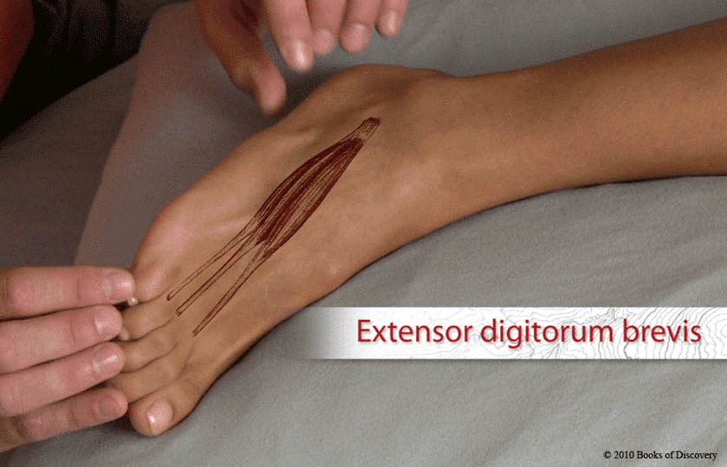
Extensor digitorum brevis

Slide 22
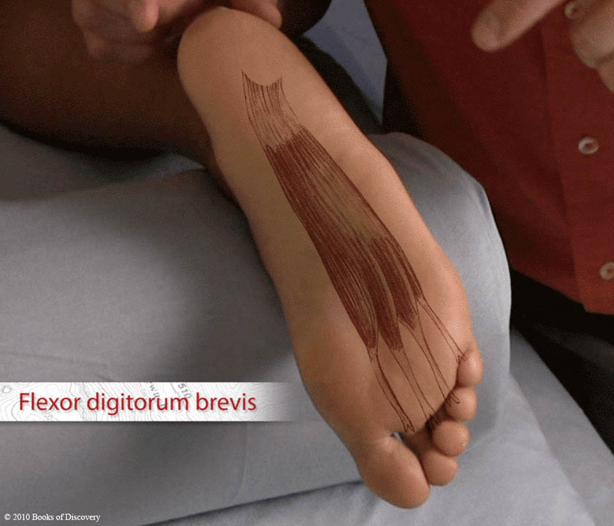
Flexor digitorum brevis

Slide 23
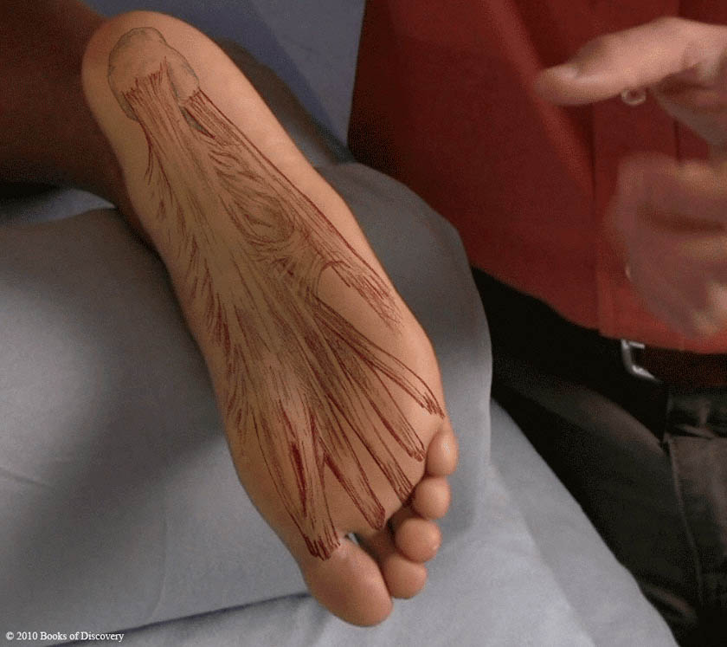
Plantar aponeurosis

